Slide 1
Arab Bank for Economic Development in Africa Together for Africa

Slide 2
Content
BADEA’s creation
BADEA’s objectives
BADEA 2030 Strategy
5 years plan (2020-2024)
Financing Mechanisms

Slide 3
BADEA’s creation
BADEA was established pursuant to the resolution of the 6th Arab Summit Conference held at Algiers in November 1973.
BADEA is a financial insitution owned by 18 Arab countries members of the League of Arab States which signed its Establishment Agreement in February 1974.
BADEA began operations in March 1975
BADEA is an independent international institution enjoying full international legal status and compelete autonomy in administrative and financial matters. It is governed by the provisions of its Establishment Agreement and by the principles of international Law.
BADEA’s headquarters is located in Khartoum, the capital of Sudan.

Slide 4
BADEA’s Objectives
BADEA was created for the purpose of strengthening economic, financial and technical cooperation between the Arab and African regions and for the embodiment of Arab-African solidarity on foundations of equality and friendship. To achieve this end, the Bank was given a mandate to:
Participate in financing economic development in African countries
Stimulate the contribution of Arab capital to African development
Help provide the technical assistance required for the development of Africa

Slide 5
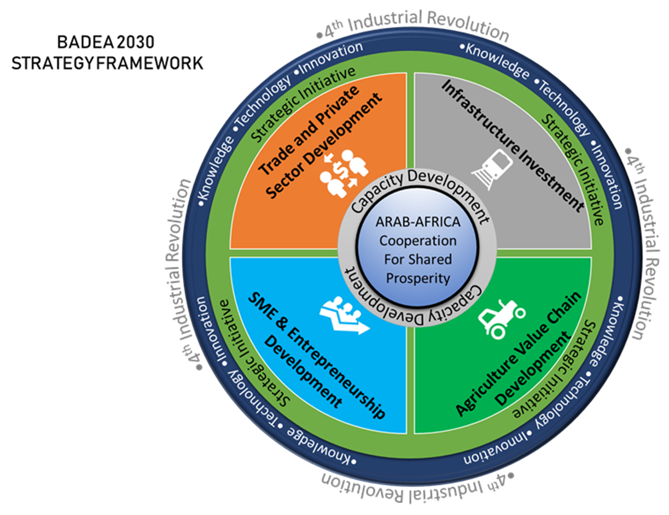
BADEA 2030 Strategy

Slide 6
Strategy’s pillars
Infrastructure Investment: Social (Education and Health), Transport (Roads, Railroads, ports, airports), Energy (generation, transportation, distribution) Industrialization (industrial zones), urban development, ITC and digital economy
Agriculture Value Chain Development: irrigation and water management, land rehabilitation, farm inputs, Livestock and aquaculture, development of agri-business and post-harvest processing, rural development.
Trade and Private Sector Development: Financial sector, mining, industrial equipment and products, building materials, tourism, knowledge and information services, divers products.
SMEs and Entrepreneurship Promotion: Youth and women empowerment, financial inclusion, support to SMEs , business incubators, cooperative and communal projects.

Slide 7
5 years plan(2020-2024)
Since 1983, BADEA has pursued its operations through 5 years plan relating the available resources to the needs of African recipient countries
Starting from 2020, BADEA will operate under its new 8th plan (2020-2024) which was approved by the Board of Governors in April 2019.
The 8th plan was prepared in line with BADEA’s 2030 strategy priorities.
New commitments under the 8th plan will reach 2750 million dollars in long and medium terms financing and 520 to 600 millions dollars on an annual basis in short-term financing.

Slide 8
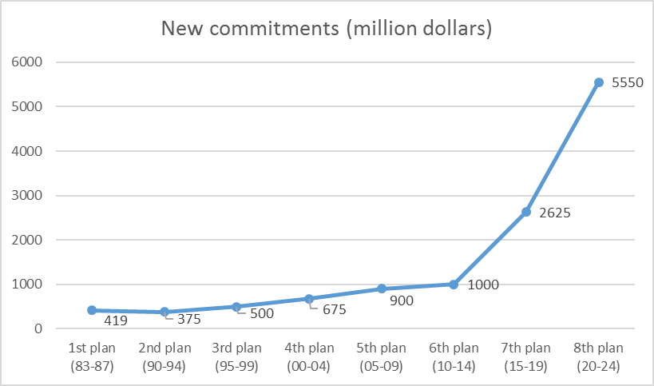
Progress of new commitments under 5 years plans

Slide 9
Objectives of the 8th plan
BADEA’s 8th plan has 4 main pillars:
Supporting development in Subsaharan Africa through financing public and private projects.
Supporting Entrepreneurship and youth and women empowerment mainly through microfinance development.
Technical Assistance to African countries
Promoting trade flows between African countries and the Arab World.

Slide 10
New annual commitments under the 8th Plan
Item |  | 2020 | 2021 | 2022 | 2023 | 2024 | Total 2020-2024
1. | Public Sector Blended financing Ordinary financing Total Public Sector | 200 100 300 | 210 110 320 | 220 120 340 | 230 130 360 | 240 140 380 | 1100 600 1700
2. | Private Sector | 150 | 175 | 200 | 225 | 250 | 1000
3 | Technical Assistance | 10 | 10 | 10 | 10 | 10 | 50
 | Total 1+ 2 +3 | 460 | 505 | 550 | 595 | 640 | 2750
4. | Trade financing program Arab exports program African Trade program Total Trade financing program | 260 260 520 | 270 270 540 | 280 280 560 | 290 290 580 | 300 300 600 | 300 * 300 * 600 *
* Revolving fund

Slide 11
BADEA’s financing mechanisms
Many financing mechanisms adapted to the African countries’ needs, among which:
Public sector projects financing through concessional, blended and ordinary loans.
Priavte sector and trade financing through ad hoc programs launched by BADEA in 2015..
Technical Assistance through non reimbursable grants financing feasibility studies, institutional support (Arab experts, training sessions)…
Support to Entrepreneurship and youth and women empowerment through lines of credit for microfinance development.

Slide 12
Public Sector projects financing
BADEA’s cumulative commitments for public development projects financing have reached 6 billion dollars for 660 operations.
Annual commitments for public sector have increased from 192 million dollars in 2010 to 300 million dollars in 2020.

Slide 13
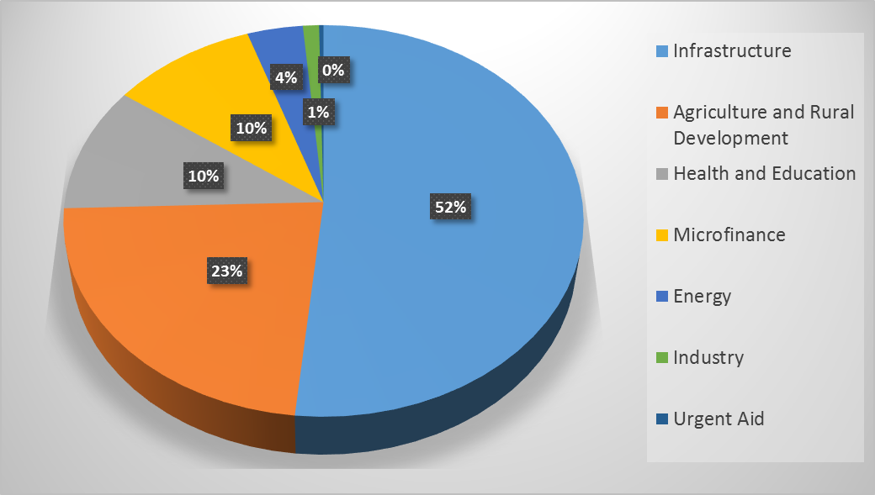
Public Sector projects financing

Slide 14
Private sector and trade financing
BADEA has launched in 2015 two new programs for private sector and trade financing.
New commitments for private sector will increase from 450 million dollars under the 7th Plan to 1 billion dollars under the 8th Plan.
New commitments for trade will increase from 250 million dollars per year under the 7th plan to 600 million dollars per year under the 8th Plan.

Slide 15
Private sector and trade financing
Under the 7th plan, trade program was exclusively focusing on financing Arab exports to Subsaharan Africa.
Under the 8th plan, trade program will include 2 distinct windows with equal resources. The first window will focus on financing Arab exports to sub-Saharan Africa while the second window will focus on financing African trade.

Slide 16
Financing technical assistance operations
Cumulative commitments for technical Assistance have reached 192 million dollars for 779 operations.
Annual commitments for technical Assistance have increased from 8 million dollars in 2008 to 10 millions dollars in 2020.

Slide 17
Financing technical assistance operations
Feasibility Studies
Institutional Support

Slide 18
Thank you for your attention

