Slide 1




TEASIMED
Towards an Efficient, Adequate, Sustainable and Interconnected Mediterranean power system
14/12/2022, Arab Electricity Regulators Forum (AERF)
Ahmed R. Elshami, Power System Advisor
A project by
Co-funded by
the European Union

Slide 2
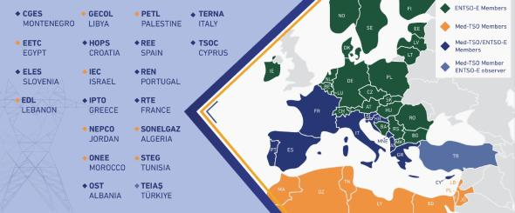
Med-TSO: multilateral cooperation in the Mediterranean
22 members from 20 Med countries
> 500 million people served
~ 544.000 MW installed capacity
~ 400.000 km transmission lines
> 1600 TWh electricity consumption
A bridge between Europe and the MENA Region, acting as THE reference regional stakeholder for electricity
Playing a regional reference role for creating a favorable climate for the development of North-South and South-South interconnections
Launching pilot projects to strengthen the integration of the MENA Power Systems
Support the EC in its Euro-Mediterranean initiatives
Bottom-up approach
Notes:
Not yet Participating are Syria, Malta and & bosnia and herzegovina

Slide 3



Main streams of Med-TSO’s action plan
a
b
c
d
Coordinated planning
Common rules
Capacity building
Interconnected Electricity Exchange Zones
  Coordinated development of HV grid
  Med Masterplan
  Power System interoperability
  Mediterranean Grid Code
  Training
  Knowledge Sharing programs
  Coordinated Adequacy assessments
  Enhance coordination in operations
2020
2022
2015
2018
Four EC-cofounded Projects
TeasiMed 2 (2023-25)

Slide 4
TEASIMED project
Five working streams:
Update the Mediterranean Masterplan, the HV Transmission Network Development plan, in close connection with ENTSO-E
Consolidate the Common Technical Regulatory Framework (CTRF) to let it become a real Mediterranean Grid Code
Identify and put into operation pilot projects on selected Interconnected Electricity Exchange Zones (IEEZ), optimizing the calculation of interconnection capacities and applying joint operational procedures
Optimized operation procedures and coordinated Adequacy assessments
Knowledge Sharing program, also through the development of a digital web platform
Based on MP1 & MP2 results, the European Commission has granted to Med-TSO the support for a new project to be carried out in the period 2020-2022
The new project TEASIMED (i.e. Towards an Efficient, Adequate, Sustainable and Interconnected MEDiterranean power system) started on 1 September 2020, with a duration of 28 months (conclusion by 31 December 2022)

Slide 5
TEASIMED Steering & coordination committee
Med-TSO
Secretary General
TEASIMED
Project Manager
TC - Economic Studies & Scenario
TC – Planning
TC – Operation
TC - Regulations & Institutions
TC - Knowledge sharing
Market Study Team
Preparation for very long scenarios (e-highway)
Methodology
Coordination in operation
Seasonal Adequacy
Mid-term Adequacy
Med-grid Network Code
Maghreb TF
Mashreq TF

Slide 6
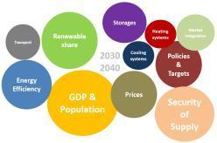
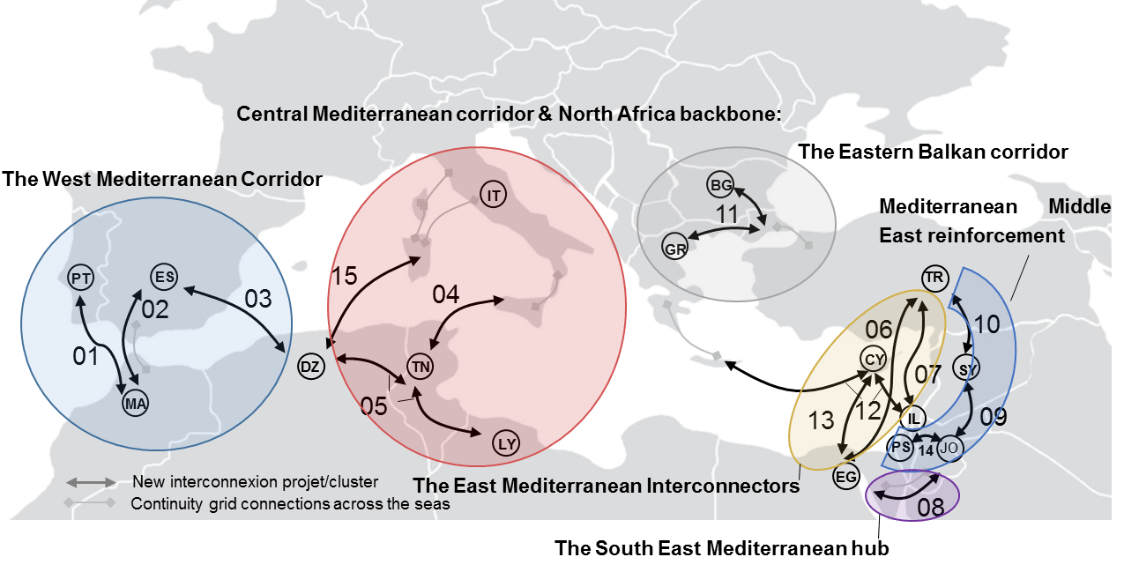
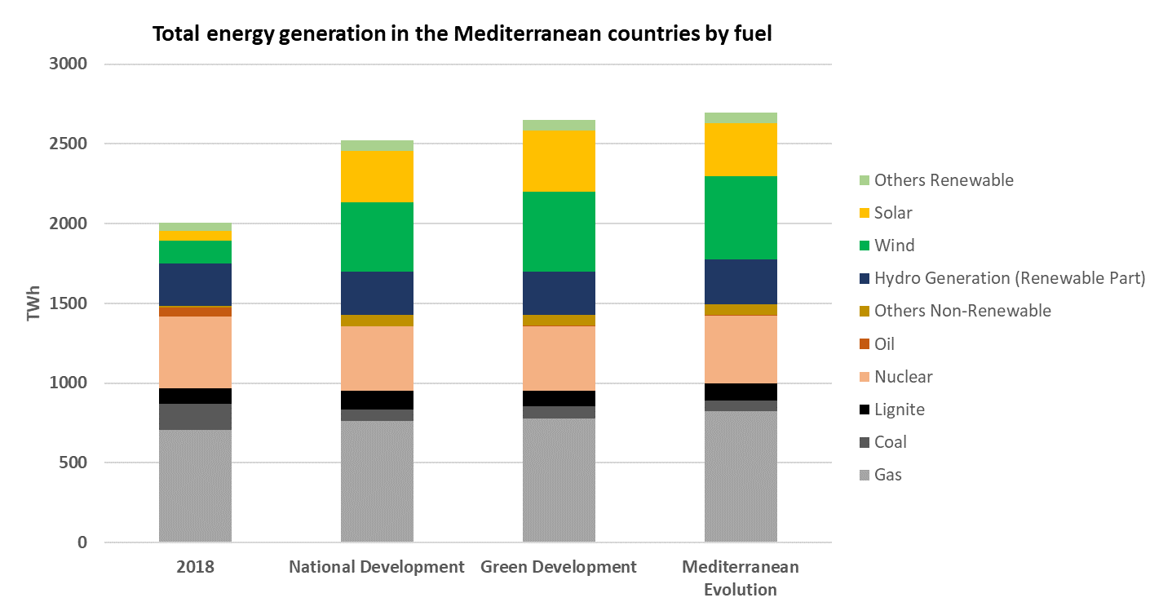
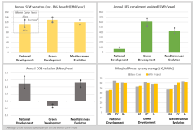
Med-TSO Mediterranean Master Plan 2022
1 - Identify main trends, drivers & uncertainties
3 - Collect list of projects after having defined common eligibility criteria
HERE PICTURE
4 - Cost-Benefit assessments
Market & Network Analysis
2 - Development of exploratory scenarios

Slide 7
Med-TSO scenarios
National development
positive but low option for long-term economic growth in the Mediterranean region
moderate population growth
commitments already made on RES and national energy policies
limited effects of energy efficiency and modest electrification of uses
Green development
Positive macroeconomic trends
Development of large RES production facilities (decentralized + prosumers
New uses of electricity to improve energy efficiency
Mediterranean Evolution
regional approach to the energy transition
strong population growth (esp. MENA)
development of industrial sectors and services
regional cooperation for ambitious RES development and GHG reduction
enhanced interconnections
New uses of electricity to improve energy efficiency

Slide 8
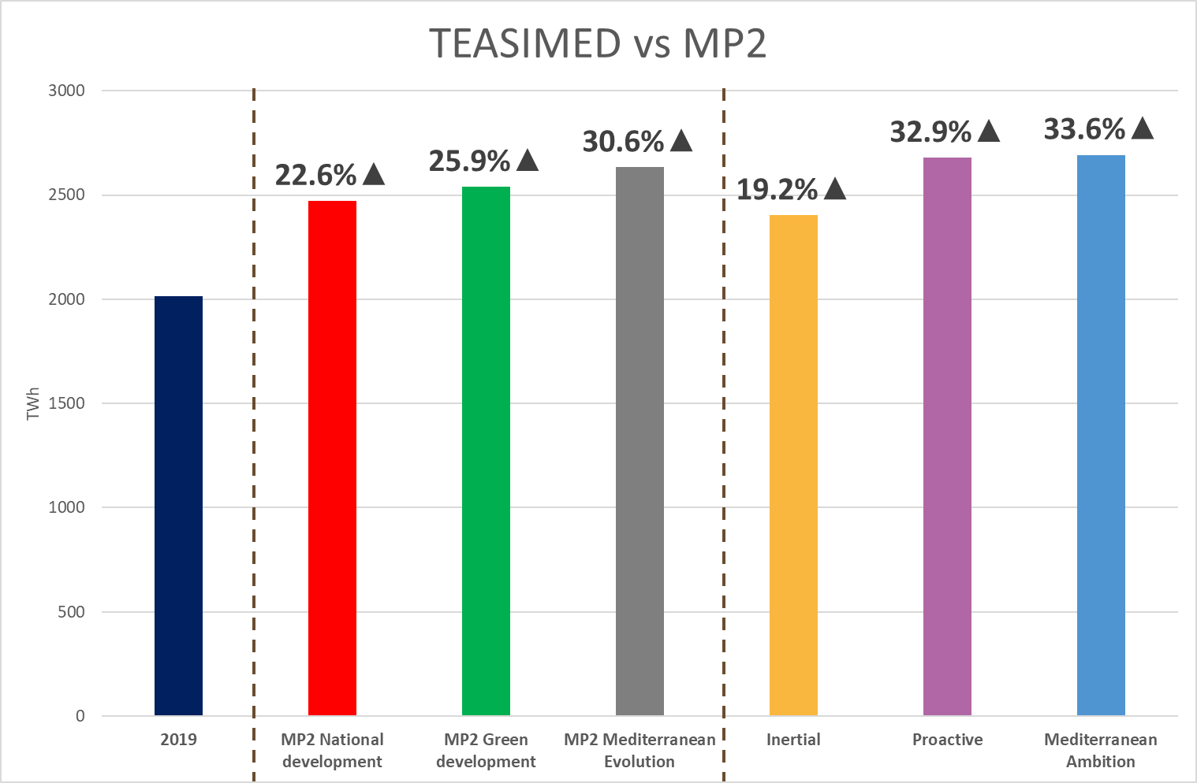
TEASIMED Scenarios - Load

Slide 9
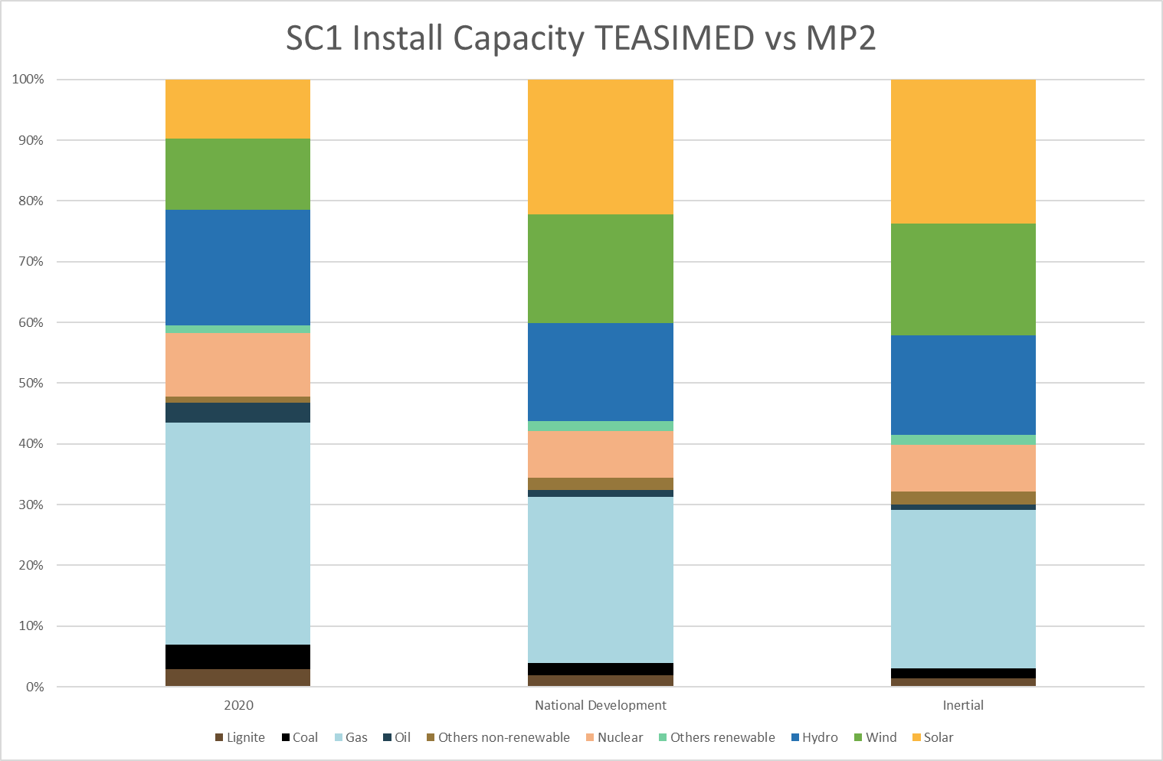
TEASIMED Scenarios – Installed capacity

Slide 10
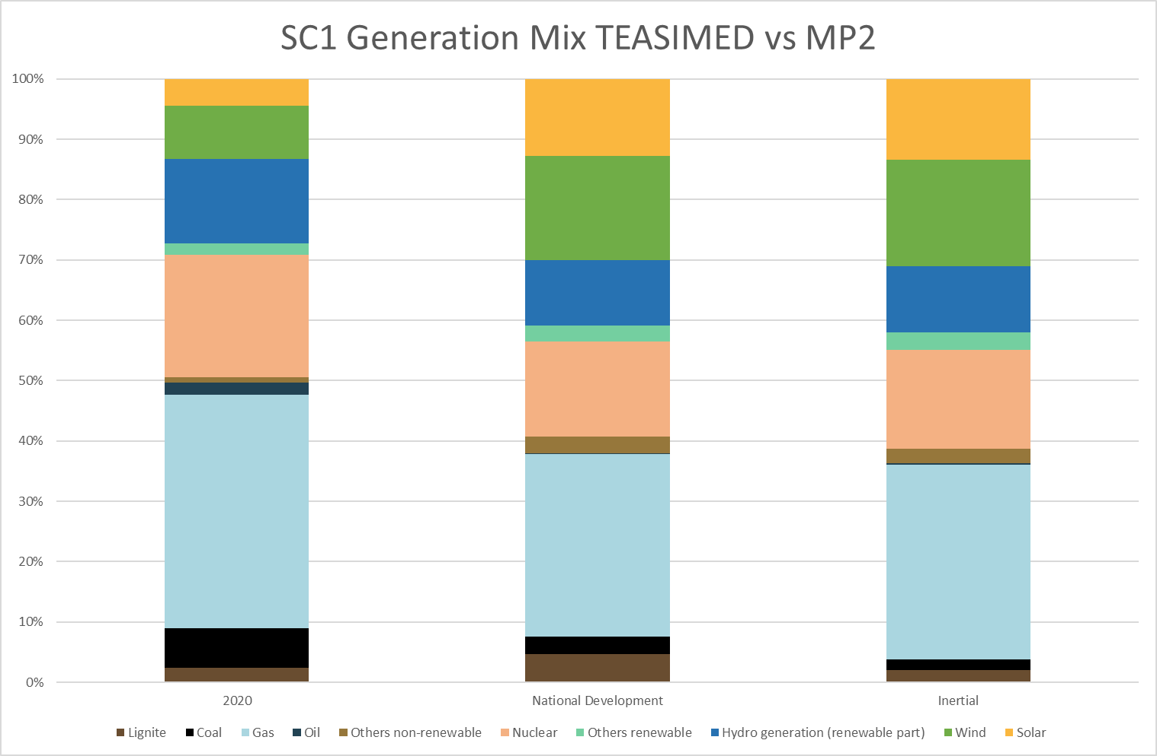
TEASIMED Scenarios – Generation

Slide 11
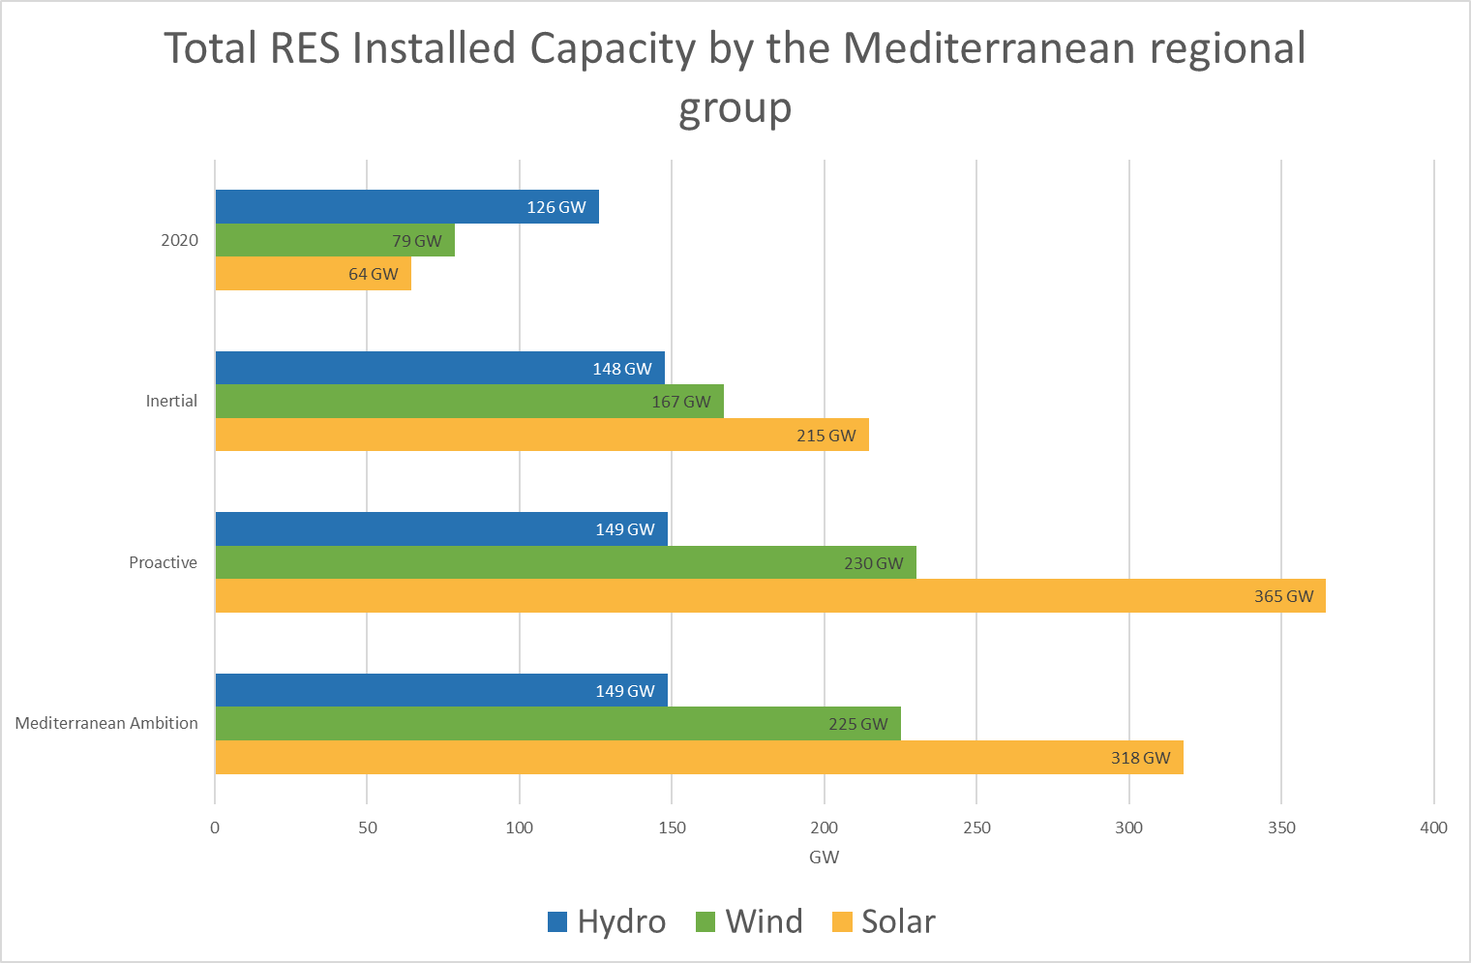
TEASIMED Scenarios – Generation

Slide 12
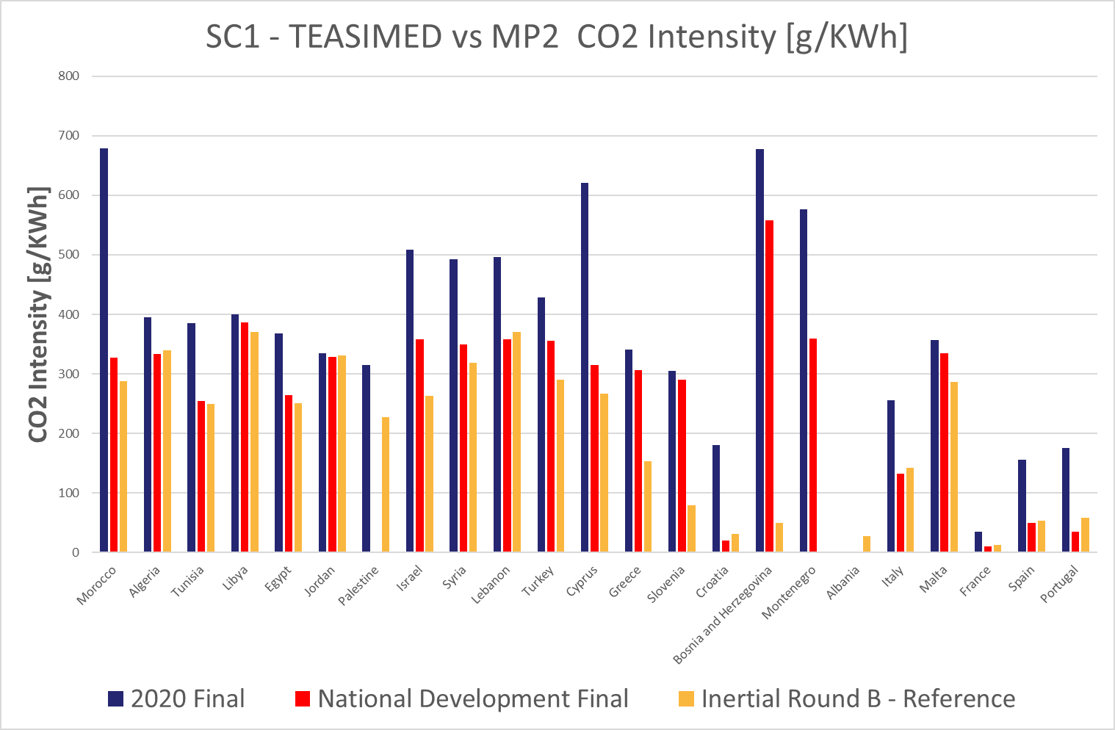
TEASIMED Scenarios – CO₂

Slide 13
2020 Master Plan outcomes
15 projects for 5800 km of additional lines
+18 GW capacity
€
+12 BEUR aggregated investment costs
AC
DC
+4100km HVDC
Selection of projects
Market and network studies
Cost-Benefit Analysis
https://masterplan.med-tso.com
https://data.med-tso.com

Slide 14
Mediterranean Masterplan 2022 – list of projects
Project 1 – Morocco (MA00) – Portugal (PT00)
Project 2 – Morocco (MA00) – Spain (ES00)
Project 3 – Algeria (DZ00) – Spain (ES00)
Project 4 – Italy (ITSI) – Tunisia (TN00)
Project 5 – Algeria (DZ00) – Tunisia (TN00)
Project 6 – Egypt (EG00) – Turkey (TR00)
Project 7 – Israel (IL00) – Turkey (TR00)
Project 8 – Egypt (EG00) – Jordan (JO00)
Project 9 – Jordan (JO00) – Syria (SY00)
Project 10 – Syria (SY00) – Turkey (TR00)
Project 11 – Bulgaria (BG00) – Greece (GR00) – Turkey (TR00)
Project 12 – Greece (GR03) – Cyprus (CY00) – Israel (IL00)
Project 13 – Cyprus (CY00) – Egypt (EG00) – with 12
Project 14 – Jordan (JO00) – Palestine (PS00)
Project 15 – Algeria (DZ00) – Italy Sardinia (ITSA)
Project 16 – Egypt – Greece
Project 17 – Italy – Greece
Project 18 – Egypt – Libya
Project 19 – Algeria – Libya

Slide 15
ELMED Project
ELMED is a strategic project complying with EU priorities and fulfilling EU Green Deal requirements:
  enable a further diversification of energy sources between Europe and MENA countries
  enable the EU market integration (through Italy) with North Africa
  facilitate the integration of RES on both the two shores of the Mediterranean
  allow reducing adequacy problems, to improve Security of Supply and sustainability
  contribute to create a Euro-Mediterranean Grid
  contribute to reach short-, medium- and long-term EU climate and energy targets for both EU and non-EU countries
Ongoing/concluded activities:
  Public consultation completed in Italy in July 2021
  Stakeholder consultation ongoing in Tunisia within the frame of the Environmental-Social Impact Assessment (ESIA)
  World Bank contributed to finance Pre-FEED & FEED studies (12.5 MUSD), compl. by 31.12.22
ELMED needs EU financing support to be realized

Slide 16
Cluster 4 – Italy Tunisia MMP2020 - Generals
On 8 December the European Commission announced the approval of a grant of about 307 million euros for the implementation of ELMED, the underwater interconnection project between Italy and Tunisia, strongly promoted by our members Terna SpA and Société Tunisienne de l'Electricité et du Gaz (STEG).
The 230 km submarine cable will connect the substations of Partanna, in Sicily and Hawaria, in Tunisia, with a capacity of 600 MW and it is expected to be completed by 2027. Its total cost should amount to 850 million euros.
The approval of this project, included in MedTSO Masterplan of Interconnections since its first edition in 2018, marks an historical step towards the creation of the Mediterranean electricity markets through the integration of the grids of the north and south shores of the Mediterranean and it will be fundamental to strengthening the energy security of the region and increase electricity production from renewable sources.
A detailed description of the project can be found in Med-TSO’s “Mediterranean Project 2” Masterplan

Slide 17
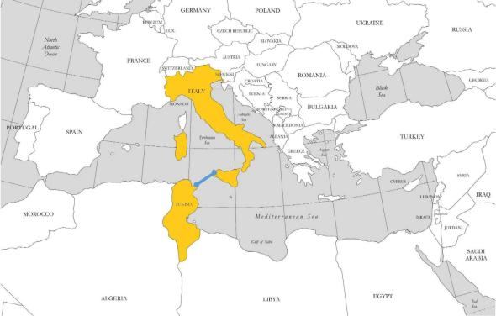
The ELMED Interconnector
First link North - South in the central corridor of Mediterranean
Expected to be completed by 2027
Promoted by Terna and STEG
Recognized as PCI since the 3rd list and in the Ten-Year Network Development Plan of ENTSO-E
Part of the reference grid considered as base case of Med-TSO studies for all the other assessed projects
Project analysed with a TOOT (Take one out at the time) methodology in the Master Plan 2020

Slide 18
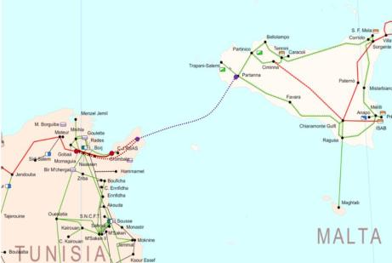
The ELMED Interconnector
Undersea HVDC interconnection between the existing electrical substation in Partanna (TP) on the Italian side and a newly built substation in Menzel Temime (Mlaaba, Cap Bon Peninsula) on the Tunisian side
Main characteristics
    Rated Power: 600 MW
    Technology: HVDC
    Maximum depth: around 800 m
    Cables length: 200 km undersea cable; 28/34 km land cables
    Construction period: 4 years
    Commissioning: 2027
    In TERNA’s Network Development Plan since 2017
    In the Tunisian National Development Plan since 2016

Slide 19
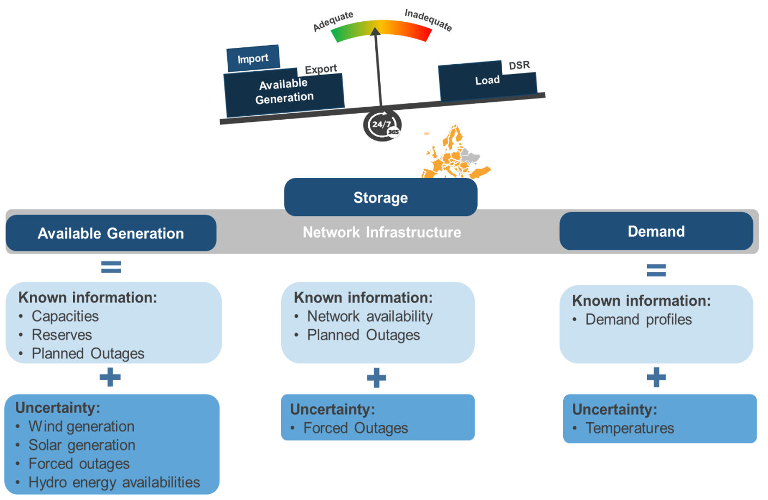




Coordinated Adequacy assessments
What’s needed to implement target methodology for Adequacy studies?
Coordinated adequacy assessment to help answering Security of Supply questions like:
  Does the country ‘A’ have enough capacity to cover power demand even under severe/extreme conditions?
  How the interconnection could reduce shortage situations?
DATA:
  TSO input
  Synthetic climate data
2. SOFTWARE
3. TRAINED ANALYSTS

Slide 20
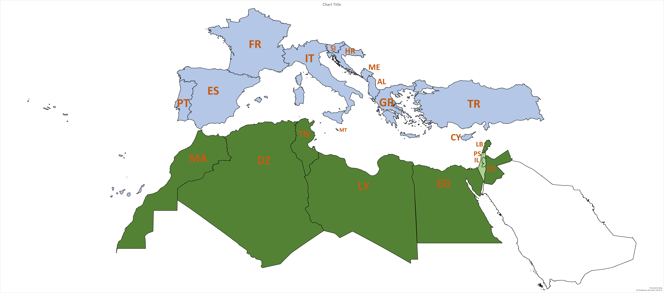
Adequacy assessment methodology
The latest development of the EU regulations and decisions put additional responsibilities on European TSOs in the process of assessing and controlling system adequacy. With the aim to follow the same development, Med-TSO decided to carry out similar investigations related to power system’s adequacy for the non-EU Med-TSO members
The Summer Outlook 2022
Winter Outlook 2022/2023
Early Summer Outlook 2023
Mid-term Adequacy Forecast 2025 & 2027
Med-TSO members that is analysed in this adequacy assessment
Med-TSO members that is not analysed in this adequacy assessment
Med-TSO members taking part to the ENTSO-E adequacy study

Slide 21
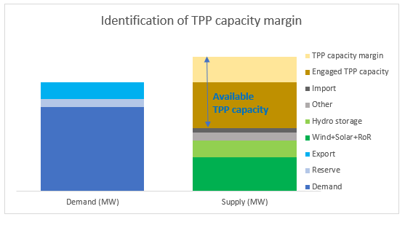
Adequacy indicators and other results of adequacy assessment
Loss of Load Expectation (LOLE) in a given geographical zone for a given period (year, season) is the expected number of hours when there is a lack of resources to cover the demand needs, within a sufficient transmission grid operational security limit.
Expected Energy Not Served (EENS) in a given geographical zone for a given period (year, season) is the expected value of energy not to be supplied due to lack of resources while complying with transmission grid operational security limit.
Relative EENS: is a more suitable indicator to compare adequacy across geographical scope as it represents the percentage of annual (seasonal) demand which is expected to be not supplied.
Dump Energy: or RES curtailment, in a given geographical zone for a given period, is the energy generated in excess that cannot be balanced, for instance when the load is low and the in-feed of renewables is high.
The Capacity Margin for a given geographical zone for a given point in time is the difference between the available capacity and the demand.

Slide 22
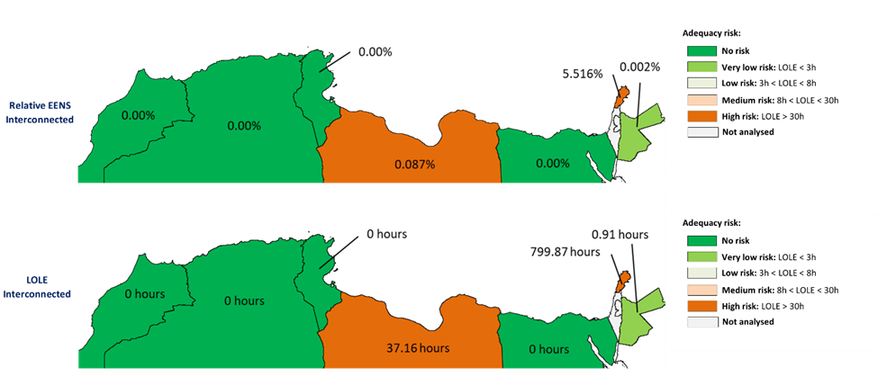
Winter Outlook 2022/2023 Adequacy assessment – Main indicators overview – interconnected operation

Slide 23

Creating an Interconnected Electricity Exchange Zone (IEEZ) - Launching pilot projects
Roadmaps set up by Med-TSO with the final goal to promote the efficient operation of interconnected electrical systems, through the use of trading web platforms
Implement a coherent and harmonized set of technical rules for the management of existing interconnections
Start the preparation of coordinated national plans for the development of HV networks
FR
SL
HR
IT
ME
ES
AL
PT
GR
TR
CY
LE
MA
ZONE 1
TN
PS
DZ
IL
JO
LY
EG
ZONE 2
ZONE 2
Joint Cooperation Agreement signed in Algiers on 22.11.2022 among COMELEC, MEDENER, Med-TSO and OME, envisaged extension to MedReg
A win-win integration with the EU energy market
Notes:
There is a strong need to develop the electricity infrastructure in the Mediterranean region
Effective Mediterranean integration will be achieved only when North – South interconnections will link regions (subregions) and not simply countries
Med-TSO promotes both the HW (development of the grid) and the SW (common ground rules) for achieving system interoperability, addressing some necessary aspects: common planning methodologies, tools and criteria to assess commercial and technical viability of projects through a shared Cost-Benefit Analysis for evaluating their regional impact and ensuring Technical interoperability

Slide 24
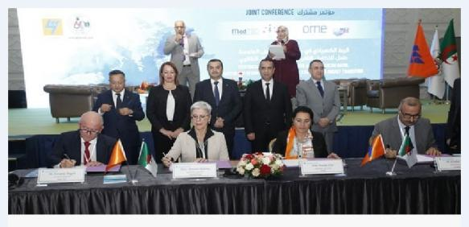
Protocole d’Algér
Joint Cooperation Agreement signed in Algiers on 22.11.2022 among COMELEC, MEDENER, Med-TSO and OME
Envisaged extension to MedReg after the Assembly of 1 December

Slide 25






Non-technical barriers to regional integration: institutional
Institutional Partnerships
  Supporting Med-TSO work programme since 2015
Med-TSO active stakeholder in REM Platform
Cooperation framework since 2014
Gradual approach
No one-size-fits-all solutions
Sub-regional approach
  Long-term joint cooperation agreement since 2017
Cooperation within UfM Energy Platforms
Cooperation within UfM energy platforms and strengthened collaboration for the development of long-term energy scenarios

Slide 26
4th EC grant (2023-2025): TEASIMED 2
Main outcomes confirmed (Masterplan, Grid Code, Pilot Projects, Knowledge Sharing, Adequacy)
Wider perimeter of activities:
  Long term scenarios (2040-50)
  Cybersecurity issues and resilience of integrated power systems
  Offshore potential assessment
  Storage and other flexibility means
  Possible cooperation in Research, Development & Innovation

Slide 27
thank you!
info@med-tso.com
A project by
Co-funded by
the European Union

